Slide 1

Introduction to Programming: Getting Started in C
Dr Nikita Singh
Assistant Professor, SoCSE

Slide 2
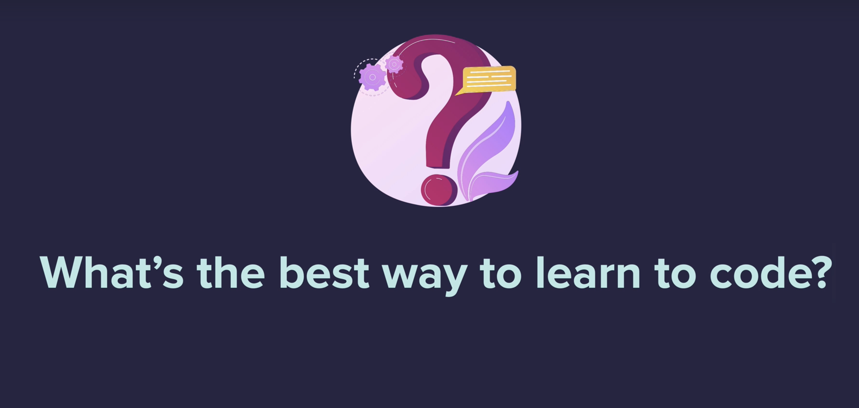

Slide 3
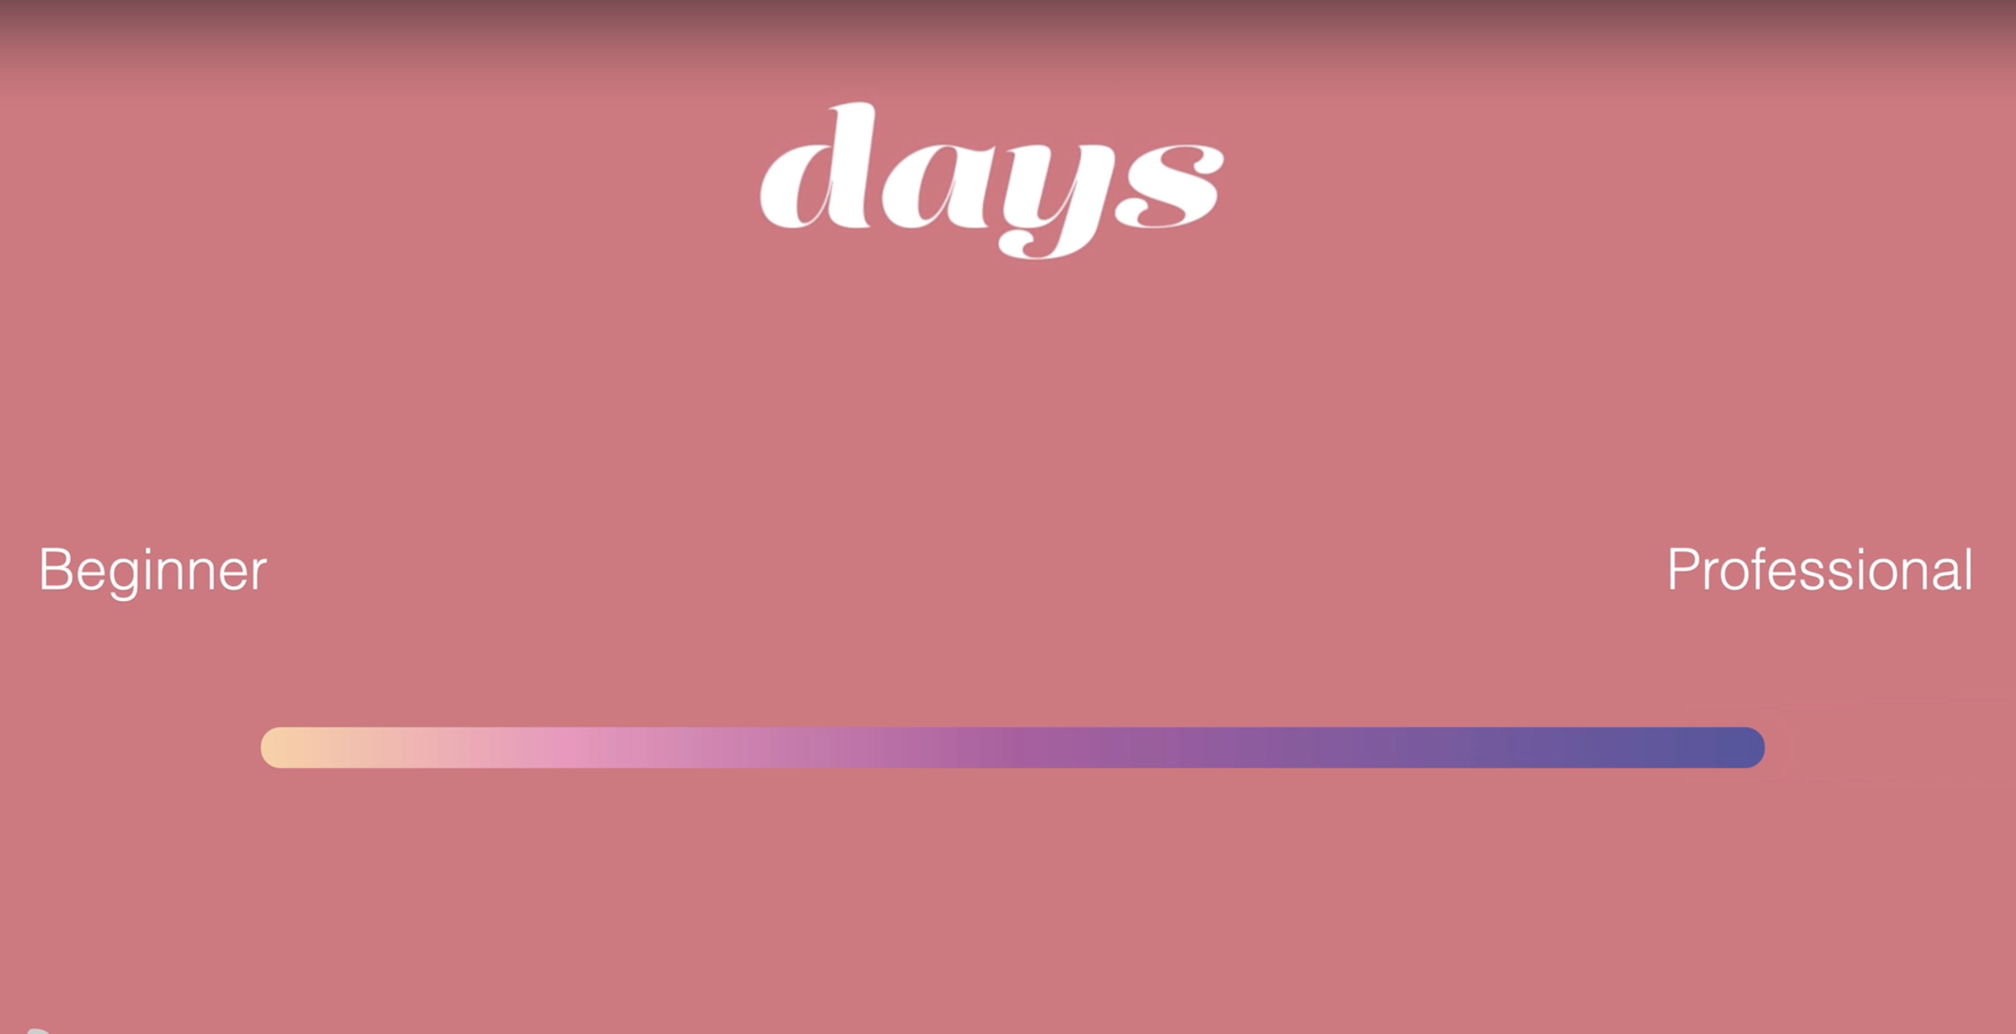
CODE FOR ONE AT LEAST HOUR EACH DAY

Slide 4
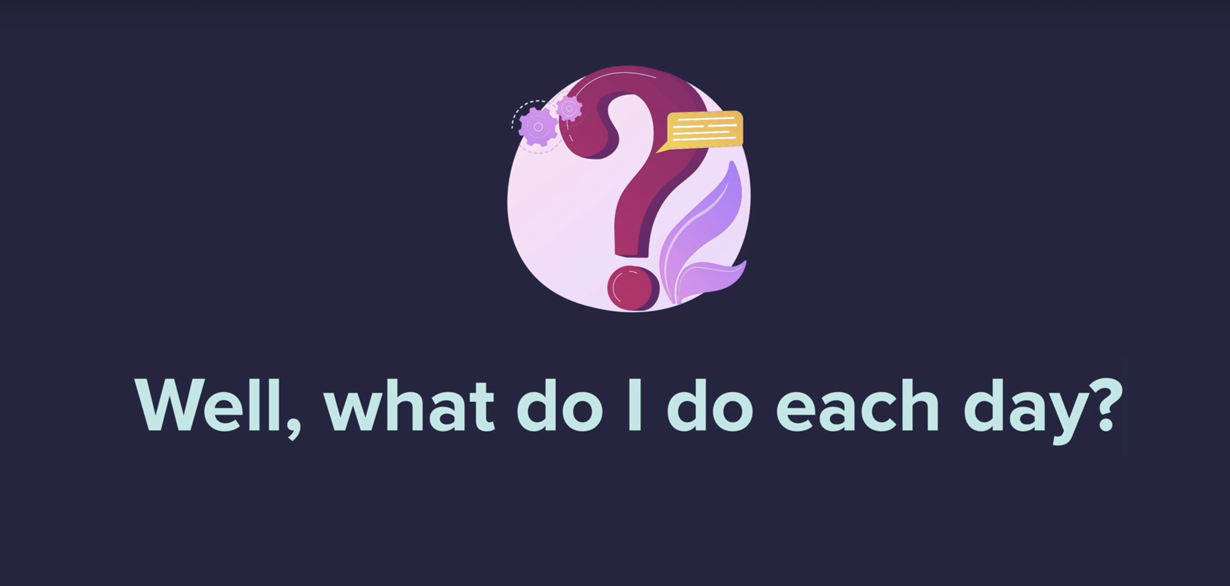

Slide 5
Some things to Remember
Code for a purpose.
Programming is a practical skill.
Dedicate 1 hour to coding each day.
Code when your mind is fresh.
Log Your Progress: Be accountable

Slide 6
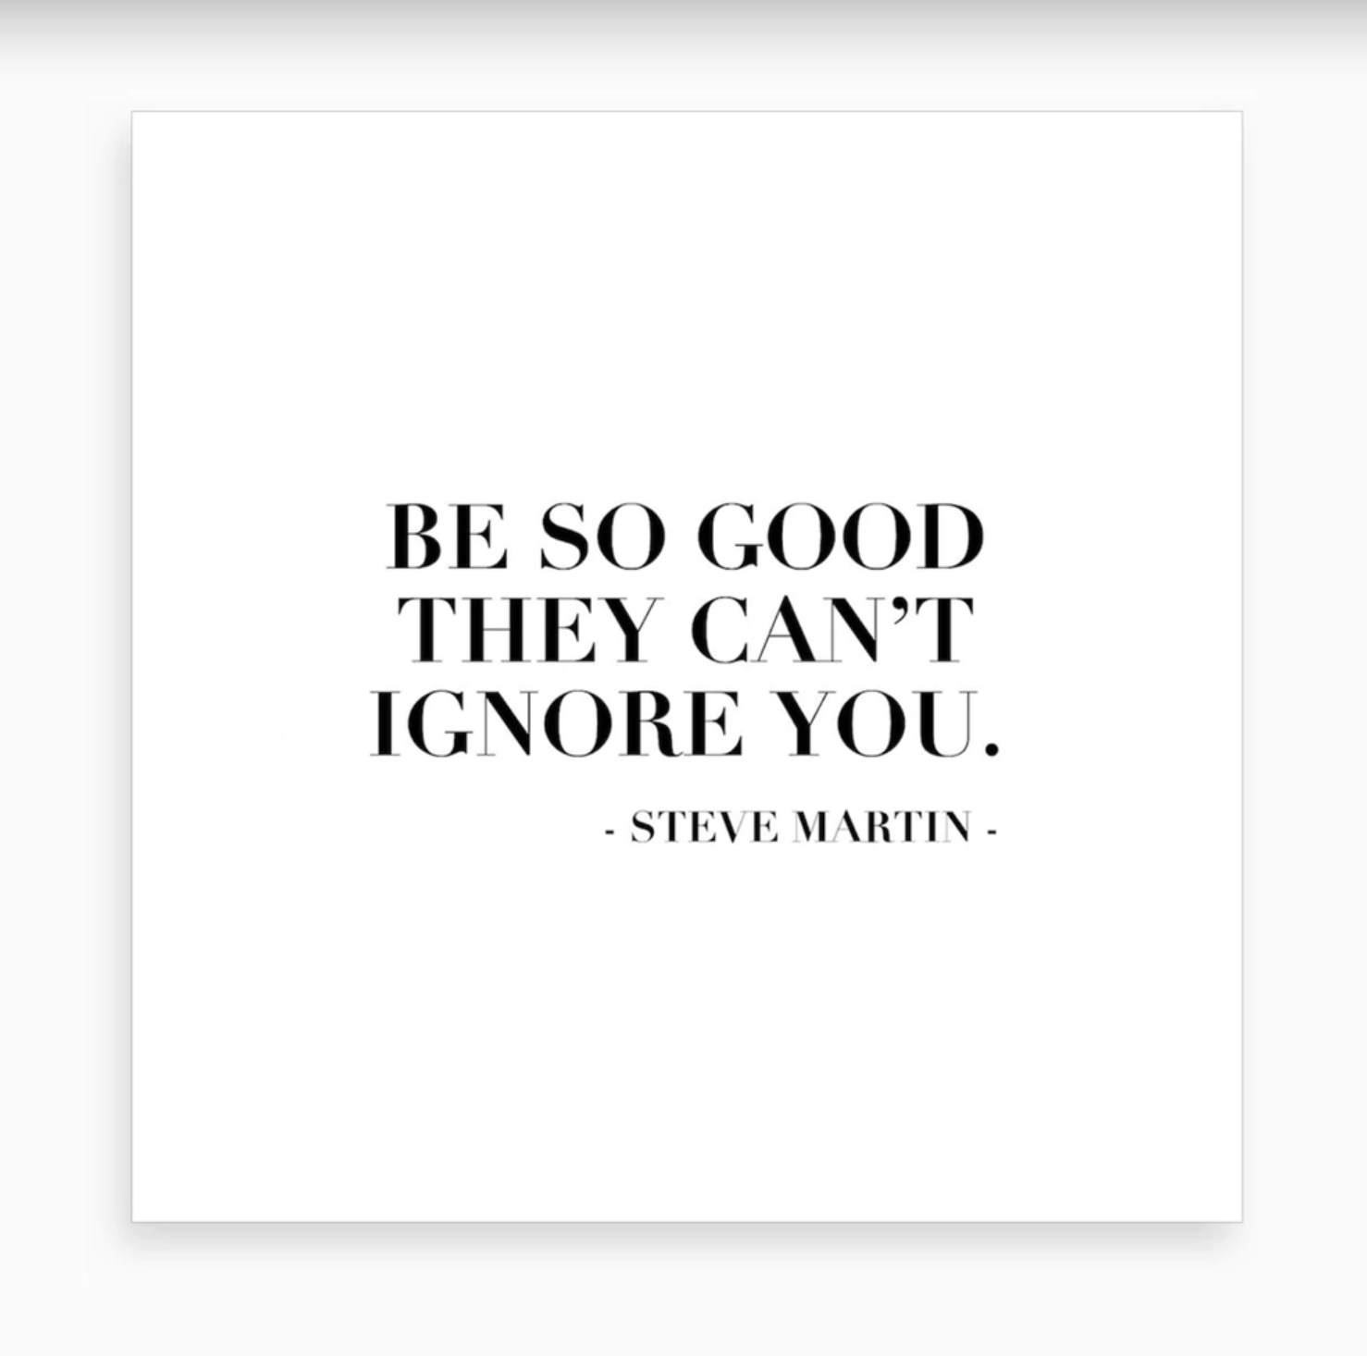

Slide 7
Lecture Objectives
Basic Programming Concepts
What is C
Getting Started with C
The C Character Set
Constants, Variables and Keywords
The First C Program
Compilation and Execution

Slide 8
What is C?
C is a programming language developed at AT & T’s Bell Laboratories of USA in 1972.
It was designed and written by a man named Dennis Ritchie.
Reliable, simple and easy to use.

Slide 9
Why learn C?
It is one of the most popular programming language in the world
If you know C, you will have no problem learning other popular programming languages such as Java, Python, C++, C#, etc, as the syntax is similar
C is very fast, compared to other programming languages, like Java and Python
C is very versatile; it can be used in both applications and technologies

Slide 10
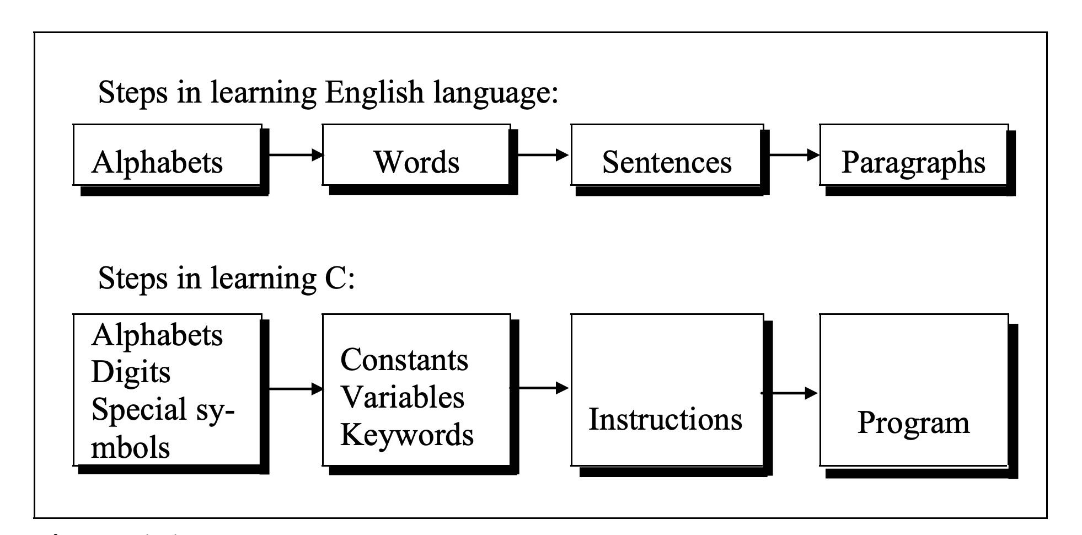
Getting Started with C

Slide 11
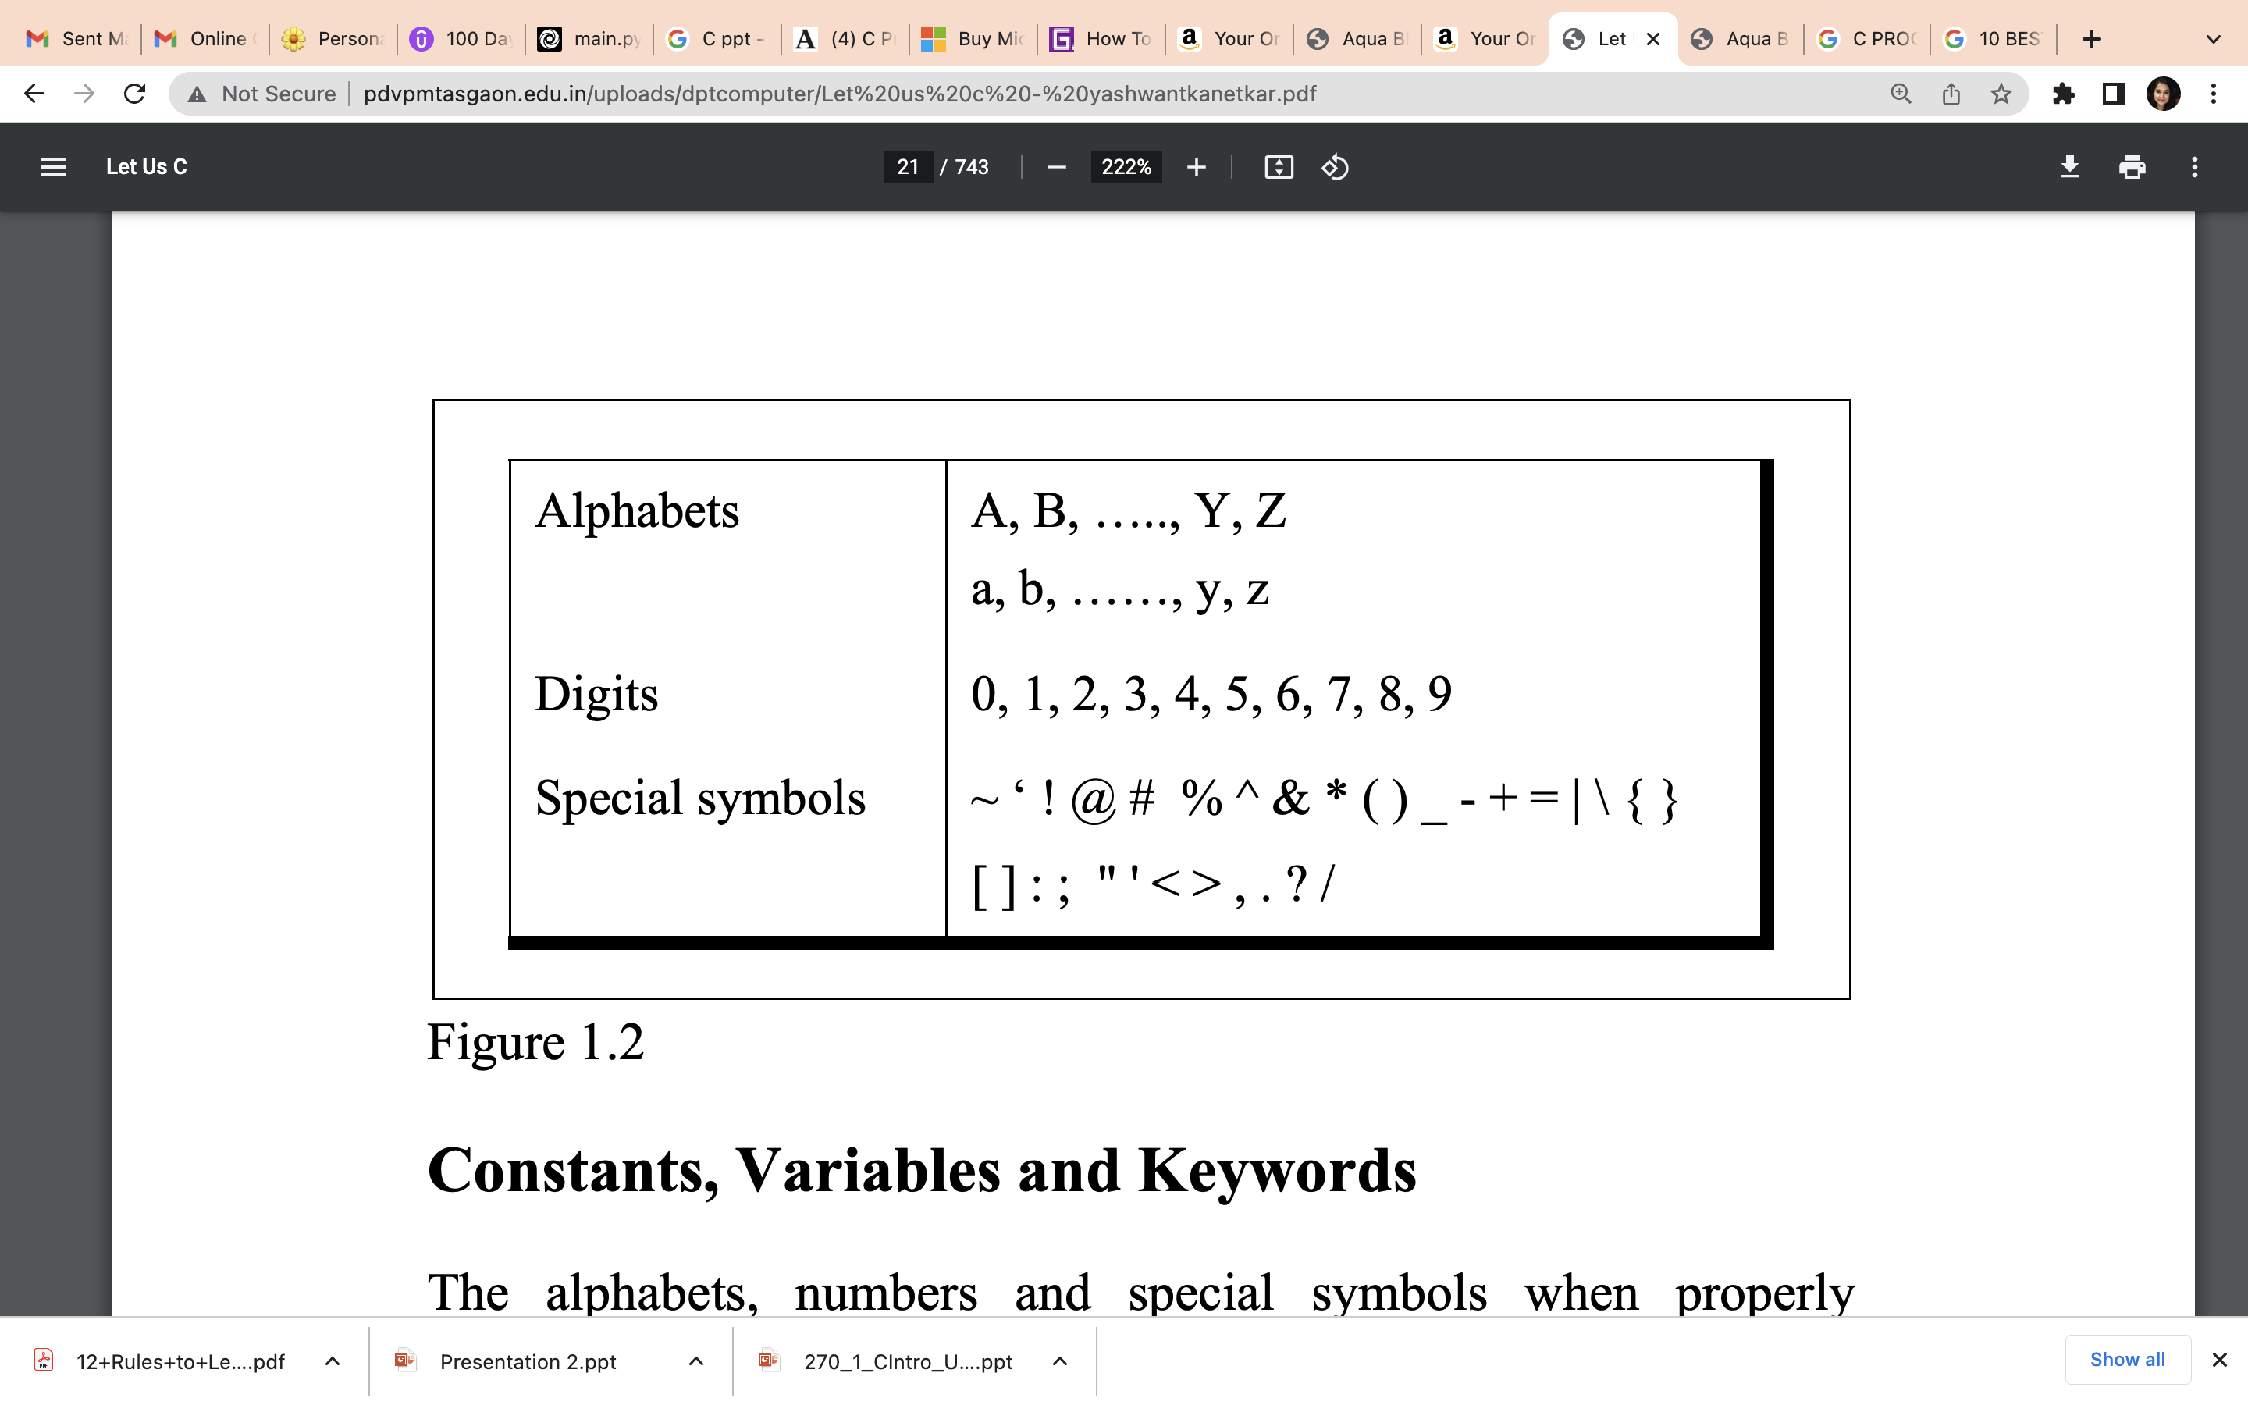
The C Character Set

Slide 12
C Variables
Variables are containers for storing data values.
In C, there are different types of variables (defined with different keywords), for example:
int - stores integers (whole numbers), without decimals, such as 123 or -123
float - stores floating point numbers, with decimals, such as 19.99 or -19.99
char - stores single characters, such as 'a' or 'B'. Char values are surrounded by single quotes

Slide 13
Declaring a variable
To create a variable, specify the type and assign it a value:
Syntax:
type variableName = value;
Example: Create a variable called myNum of type int and assign the value 15 to it.
int myNum = 15;

Slide 14
Rules for Constructing Variable Names
A variable name is any combination of alphabets, digits or underscores. Some compilers allow variable names whose length could be up to 247 characters..
The first character in the variable name must be an alphabet or underscore.
No commas or blanks are allowed within a variable name.
No special symbol other than an underscore can be used in a variable name.
Ex.: si_int
m_hra
pop_e_89

Slide 15
C Data Types
A variable in C must be a specified data type, and you must use a format specifier inside the printf() function to display it.
Example
int myNum = 5; // Integer (whole number) float myFloatNum = 5.99; // Floating point number char myLetter = 'D'; // Character
Print variable
printf("%d\n", myNum); printf("%f\n", myFloatNum); printf("%c\n", myLetter);

Slide 16
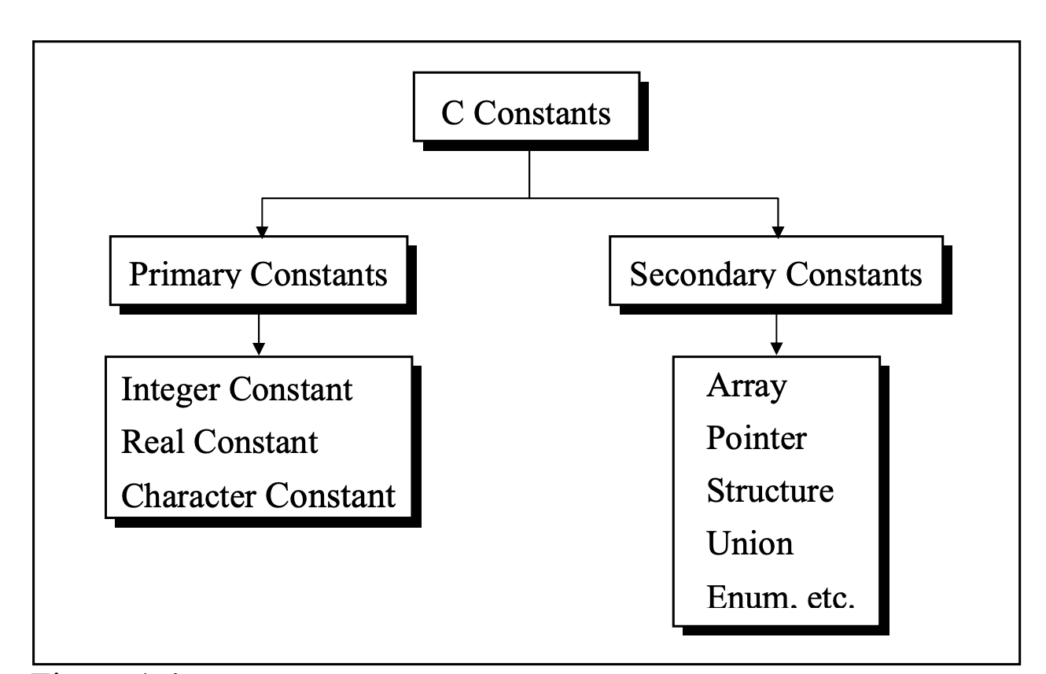
Figure: C Constants

Slide 17
C Keywords
Keywords are the words whose meaning has already been explained to the C compiler (or in a broad sense to the computer).
The keywords cannot be used as variable names because if we do so we are trying to assign a new meaning to the keyword, which is not allowed by the computer.
There are only 32 keywords available in C.

Slide 18
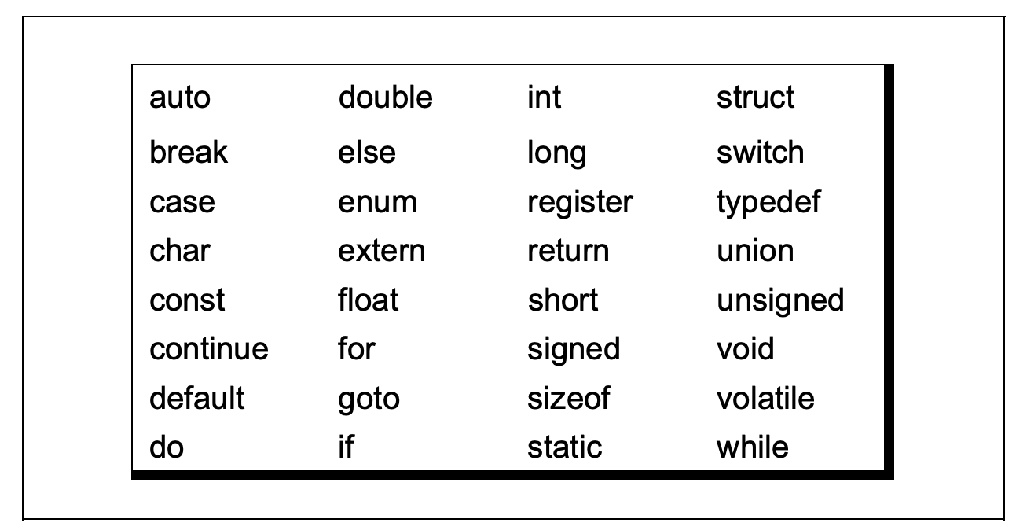

Slide 19
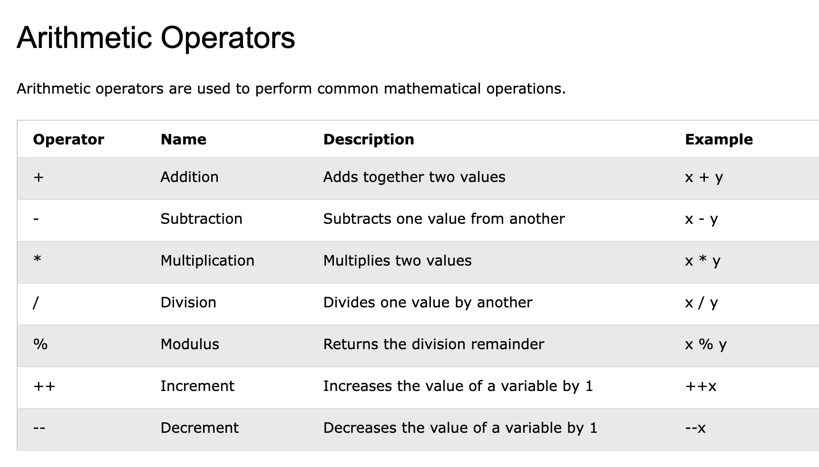
C Operators
Operators are used to perform operations on variables and values.

Slide 20
Assignment Operators
Assignment operators are used to assign values to variables.
In the example below, we use the assignment operator (=) to assign the value 10 to a variable called x:
Example
int x = 10;

Slide 21
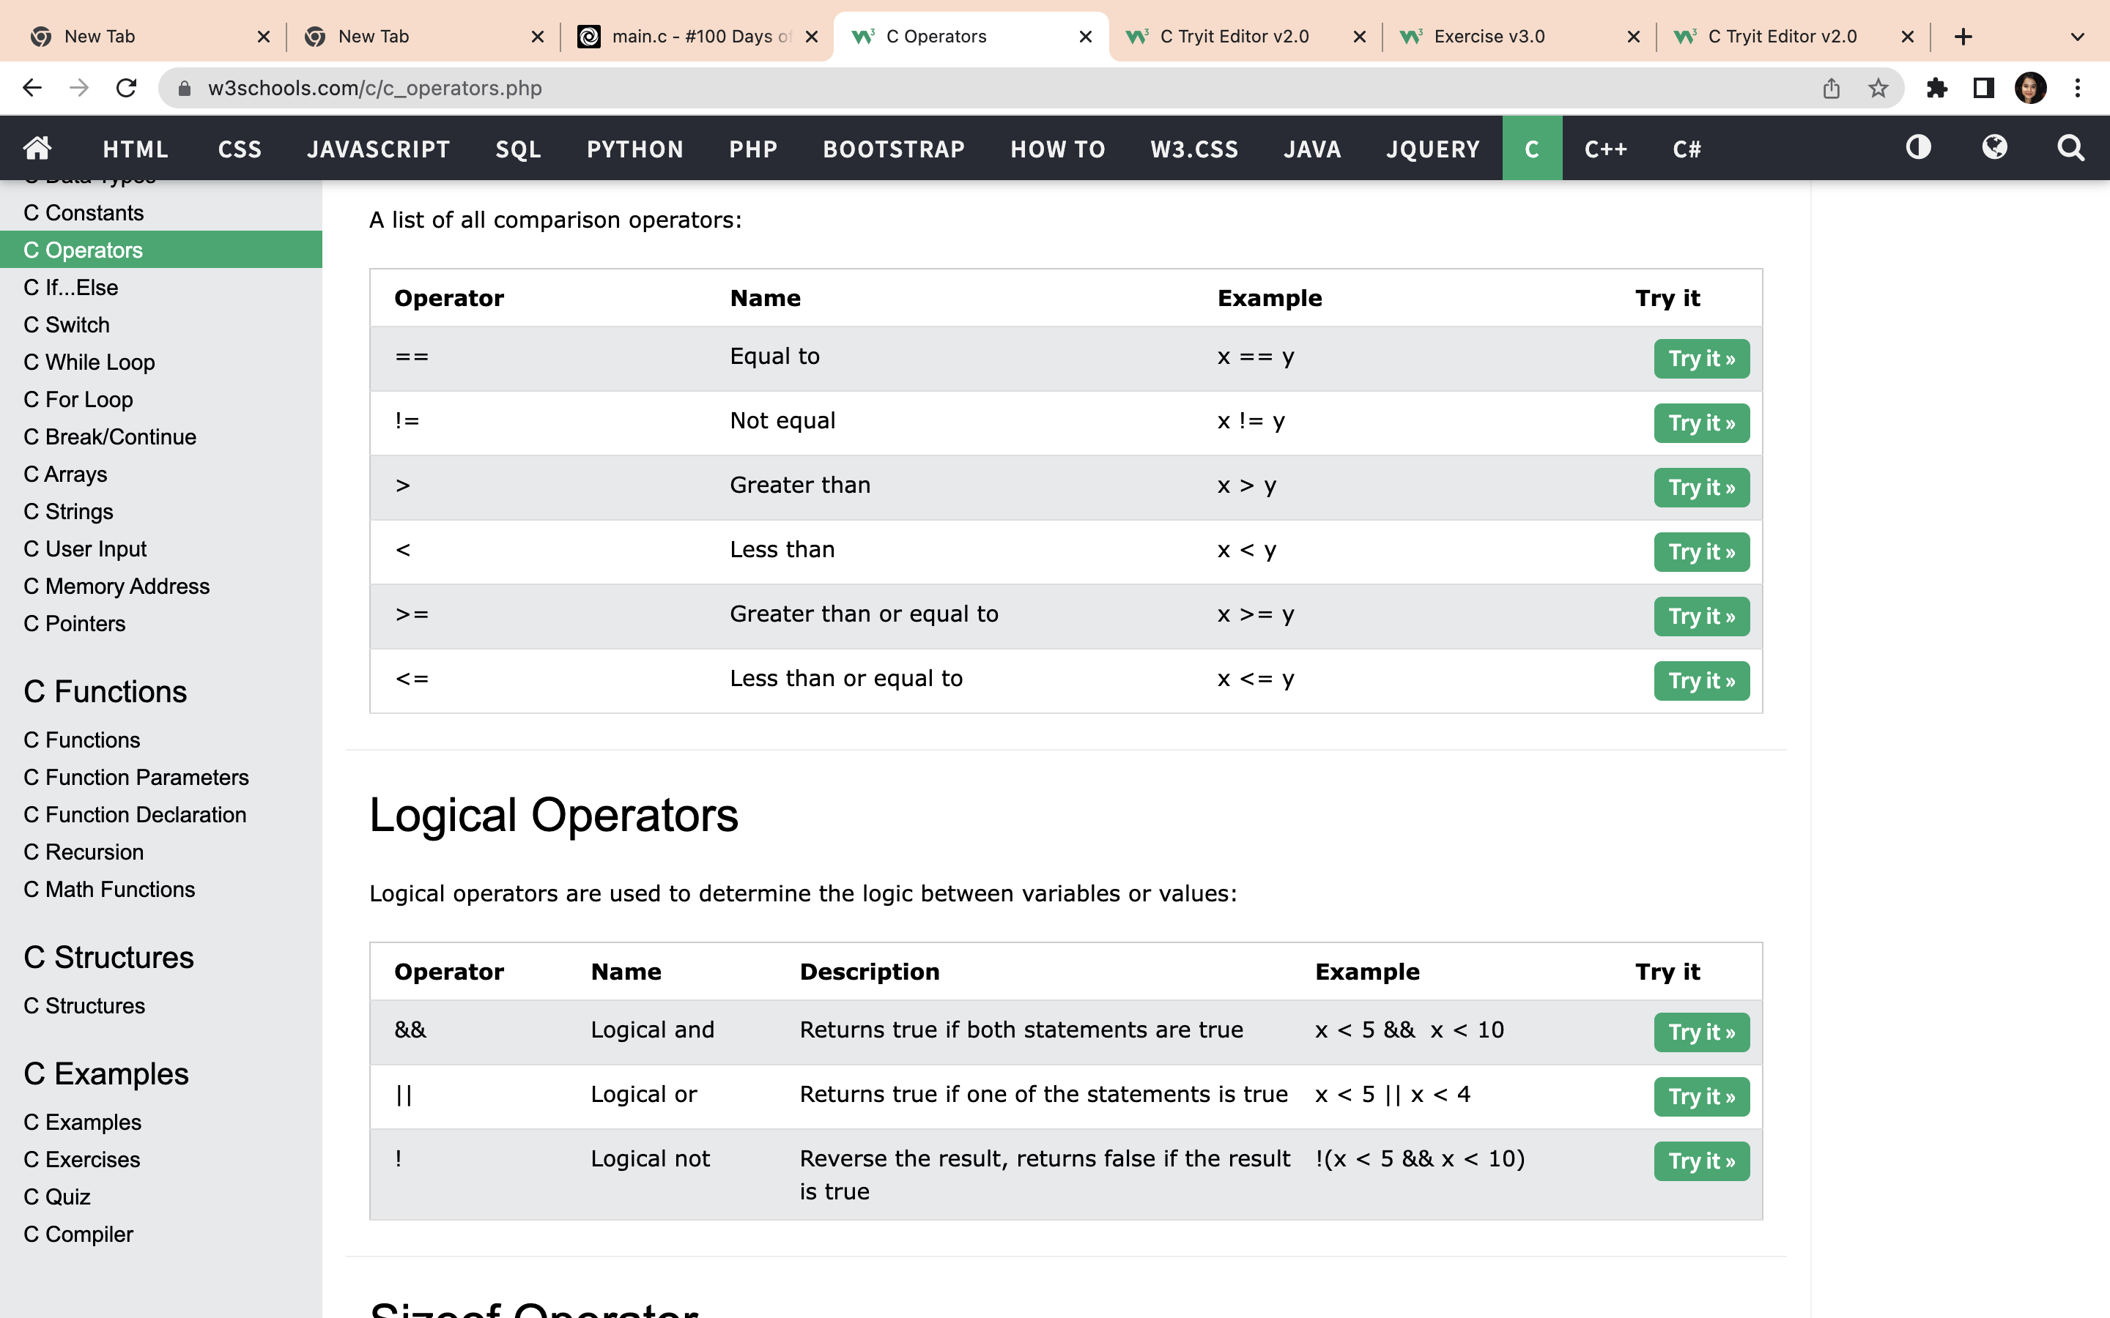
Comparison Operator

Slide 22
Logical Operators

Slide 23
The First C Program
#include <stdio.h>
main()
{
printf(“Hello World”);
}
Note: C ignores white spaces

Slide 24
Program to Add Two Numbers
#include <stdio.h>
main()
{
int a = 10;
int b = 20;
int c = a + b;
printf(“%d”, c);
}
Header library file
Indicates that we are
reading an integer

Slide 25
Let’s rewrite the average program so it can find the average any 3 numbers we try:
We now need to:
Find our three values
Add the values
Divide the sum by 3
Print the result

Slide 26
Exercises
Write a C program to store your name in a variable and print it.
Write a Program to calculate Simple Interest
Write a Program to Add to numbers
Write a Program to print larger of the two numbers
Write a program to swap two numbers

Slide 27
Taking Input from the User/Receiving Inputs
Receiving inputs achieved using a function called scanf( ).
This function is a counter-part of the printf( ) function.
printf( ) outputs the values to the screen whereas scanf( ) receives them from the keyboard.
int p, n ;
float r, si ;
printf ( "Enter values of p, n, r" ) ;
scanf ( "%d %d %f", &p, &n, &r ) ;

Slide 28
#include <stdio.h>
int main(void)
{
int value1, value2, value3;
float sum, average;
printf("What is the first value? ");
scanf("%d", &value1);
printf("What is the second value? ");
scanf("%d", &value2);
printf("What is the third value? ");
scanf("%d", &value3);
sum = value1 + value2 + value3;
average = sum / 3;
printf("The average of %d , %d, %d is %f\n", value1, value2, value3, average); return(0);
}

Slide 29
Main Function
A main is a predefined keyword or function in C.
It is the first function of every C program that is responsible for starting the execution and termination of the program.
It is a special function that always starts executing code from the 'main' having 'int' or 'void' as return data type.
In other words, a main() function is an entry point of the programming code to start its execution.

Slide 30
If – Else
C has the following conditional statements:
Use if to specify a block of code to be executed, if a specified condition is true
Use else to specify a block of code to be executed, if the same condition is false
Use else if to specify a new condition to test, if the first condition is false

Slide 31
Syntax
if (condition1)
{ // block of code to be executed if condition1 is true }
else if (condition2)
{ // block of code to be executed if the condition1 is false and condition2 is true }
else
{ // block of code to be executed if the condition1 is false and condition2 is false }

Slide 32
Conditional Operator
The conditional operators ? and : are sometimes called ternary operators since they take three arguments.
Their general form is,
expression 1 ? expression 2 : expression 3
int x, y ;
scanf ( ” %d", &x );
y = ( x > 5 ? 3 : 4 );
scanf ( ” %d", &i ) ;
( i == 1 ? printf ( "Amit" ) : printf ( "All and sundry" ) ) ;

Slide 33

Quick Quiz

Slide 34
(a) main( )
{
int i ;
printf ( "Enter value of i " ) ;
scanf ( "%d", &i ) ;
if ( i = 5 )
printf ( "You entered 5" ) ;
else
printf ( "You entered something other than 5" ) ;
}
(b) main( )
{
int x = 3 ;
float y = 3.0 ;
if ( x == y )
printf ( "\nx and y are equal" ) ;
else
printf ( "\nx and y are not equal" ) ;
}

Slide 35
(e) main( )
{
int i = -3, j = 3 ;
if ( !i + !j * 1 )
printf ( "\nMassaro" ) ;
else
printf ( "\nBennarivo" ) ;
}
(f) main( )
{
int i = 4, z = 12 ;
if ( i = 5 || z > 50 )
printf ( "\Burger" ) ;
else
printf ( "\nDosa" ) ;
(c)main( )
{
int a = 5, b, c ;
b = a = 15 ;
c = a < 15 ;
printf ("\na = %d b = %d c = %d", a, b, c ) ;
(d) main( )
{
int x = 10, y = 20 ;
if ( x == y )
printf ("\n%d %d", x, y ) ;
}

Slide 36
(g) main( )
{
int x = 3, y, z ;
y = x = 10 ;
z = x < 10 ;
printf ( "\nx = %d y = %d z = %d", x, y, z ) ;
}
(h) main( )
{
int i = 65 ;
char j = ‘A’ ;
if ( i == j )
printf ( “C is WOW” ) ;
else
printf( "C is a headache" ) ;
}
(i) main( )
{
int j = 4, k ;
k = !5 && j ;
printf ( "\nk = %d", k ) ;
}
(j) main( )
{
int i = 4, j = -1, k = 0, w, x, y;
w = i || j || k ;
x = i && j && k ;
y = i || j && k ;
printf ( "\nw = %d x = %d y = %d, w, x, y) ;
}

Slide 37
Exercises
Printing ASCII value of a character
Take 5 subjects as input from the user:
Greater than 60 -> First Division
Between 50 and 60 -> Second Division
Between 40 and 50 -> Second Division
Less than 40 -> Fail
Any integer is input through the keyboard. Write a program to find out whether it is an odd number or even number.
Write a program to determine whether the year is a leap year or not. (Hint: Use the % (modulus) operator)
If the ages of Ram, Shyam and Ajay are input through the keyboard, write a program to determine the youngest of the three.
Write a program to check whether a triangle is valid or not, when the three angles of the triangle are entered through the keyboard. A triangle is valid if the sum of all the three angles is equal to 180 degrees.

Slide 38
Given the length and breadth of a rectangle, write a program to find whether the area of the rectangle is greater than its perimeter. For example, the area of the rectangle with length = 5 and breadth = 4 is greater than its perimeter.
C program to convert temperature from Fahrenheit to Celsius and Celsius to Fahrenheit
Program to check whether a number is prime or not.
A company insures its drivers in the following cases:
− If the driver is married.
− If the driver is unmarried, male & above 30 years of age.
− If the driver is unmarried, female & above 25 years of age.
In all other cases the driver is not insured. If the marital status, sex and age of the driver are the inputs, write a program to check whether the driver is to be insured or not.
If cost price and selling price of an item is input through the keyboard, write a program to determine whether the seller has made profit or incurred loss. Also determine how much profit he made or loss he incurred.

Slide 39
A certain grade of steel is graded according to the following conditions:
(i) Hardness must be greater than 50
(ii) Carbon content must be less than 0.7
(iii) Tensile strength must be greater than 5600
The grades are as follows:
Grade is 10 if all three conditions are met
Grade is 9 if conditions (i) and (ii) are met
Grade is 8 if conditions (ii) and (iii) are met
Grade is 7 if conditions (i) and (iii) are met
Grade is 6 if only one condition is met
Grade is 5 if none of the conditions are met

Slide 40
The loop control structure
Repeating some portion of the program either a specified number of times or until a particular condition is being satisfied. This repetitive is done through a loop control instruction.
There are three methods by which we can repeat part of the program. They are:
(a) Using a for statement
(b) Using a while statement
(c) Using a do-while statement

Slide 41
The while loop
The general form of while is as shown below:
initialise loop counter ;
while ( test loop counter using a condition )
{
do this ;
and this ;
increment loop counter ;
}

Slide 42
The for loop
The for loop allows us to specify three things about the program in a single line:
Setting a loop counter to an initial value.
Testing the loop counter to determine whether its value has reached the number of repetitions desired.
Increasing the value of loop counter each time the program segment within the loop has been executed.
The general form is:
for ( initialise counter ; test counter ; increment counter )
{
statement ;
statement ;
}

Slide 43
Exercises
Write a program in C to display the first 10 natural numbers.
Expected Output : 1 2 3 4 5 6 7 8 9 10
Write a C program to find the sum of first 10 natural numbers.
Expected Output : The first 10 natural number is : 1 2 3 4 5 6 7 8 9 10 The Sum is : 55
Write a program in C to read n numbers from keyboard and find their sum and average.
Expected Output : The sum of 10 no is : 55 The Average is : 5.500000

Slide 44
Write a program in C to display the multiplication table of a given integer. Test Data : Input the number (Table to be calculated) : 15 Expected Output : 15 X 1 = 15 ... ... 15 X 10 = 150
Program to take a number as an input then then print reverse of the number.
Write a C program to count number of digits in a number.
Write a C program to find sum of all even numbers between 1 to n.
Write a C program to find sum of first and last digit of a number.
Write a C program to swap first and last digits of a number.
Write a C program to calculate sum of digits of a number.
Write a program to find the factorial value of any number entered through the keyboard

Slide 45
Write a program to find the factorial value of any number entered through the keyboard.
Two numbers are entered through the keyboard. Write a program to find the value of one number raised to the power of another.
Write a program to print all the ASCII values and their equivalent characters using a for loop. The ASCII values vary from 0 to 255.
Write a program to calculate overtime pay of 10 employees. Overtime is paid at the rate of Rs. 12.00 per hour for every hour worked above 40 hours. Assume that employees do not work for fractional part of an hour.
Write a C program to check whether a number is Prime number or not.
Write a C program to print all Prime numbers between 1 to n.
Write a C program to find sum of all prime numbers between 1 to n.

